Slide 1
Introducing the Catalysts for the Interventional Glaucoma Revolution

Slide 2

Thanks for joining us today!
Why We Are Here
Interventional Glaucoma–You play a big part!
Today’s discussion
  Glaucoma overview
  Understanding Interventional Glaucoma
  Your role in adopting an Interventional Glaucoma mindset in
  your practice

Slide 3
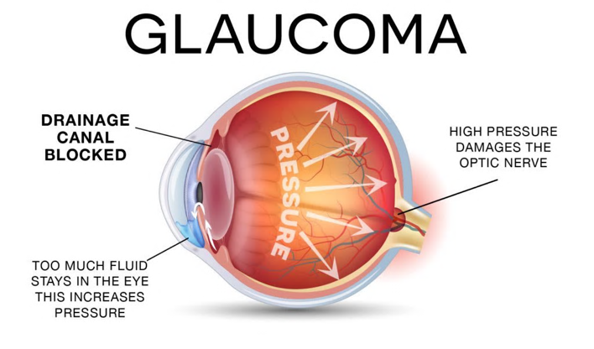
Understanding Glaucoma: A Quick Primer
What
One of the leading causes of blindness in the US, especially in elderly people¹
A common group of eye diseases that may not have symptoms and causes damage to the optic nerve, resulting in progressive, irreversible vision loss
Open-angle glaucoma (OAG) is the most prevalent type of glaucoma, accounting for at least 90% of all cases
Who
Anyone can develop glaucoma, but certain groups are at higher risk:
  African Americans over age 40
  All people over age 60
  People with a family history of glaucoma and those with diabetes
1. Vision loss from eye diseases will increase as Americans age. National Institutes of Health; National Eye Institute. April 12, 2004. Accessed August 2, 2024. https://www.nei.nih.gov/about/news-and-events/news/vision-loss-eye-diseases-will-increase-americans-age

Slide 4
Today’s Glaucoma Treatment Landscape
The most common treatment for open-angle glaucoma and ocular hypertension is prescription eye drops.
Once diagnosed, many patients are advised to use prescription eye drops and “watch and wait” until evidence of disease progression before changing treatment.
While prescription eye drops can be effective,
they may also pose challenges for patients, which can lead to disease progression.

Slide 5
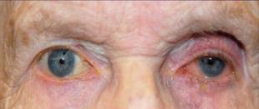
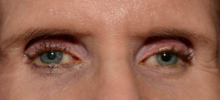
Glaucoma Treatment Challenges
Prescription eye drops can pose several challenges for patients:
1. High rates of noncompliance and nonadherence that may contribute to disease progression¹⁻⁴
>90% of patients are noncompliant with medication use
~50% of patients stop using medication(s) within
6 months
2. Uncomfortable side effects that include⁵⁻⁸
Hyperemia (red eyes)
Periorbital fat atrophy (sunken eyelids)
Ocular surface disease (eg, dry eye)
Hyperchromia (change in iris color)
Imperial College NHS Trust, United Kingdom (photo credit)
What Challenges Are You Seeing With Patients?
1. Analysis of Market, Claims, and Compliance Data. Data on file. Glaukos Corporation. 2. Nordstrom BL, et al. Am J Ophthalmol. 2005;140(4):598-606. doi:10.1016/j.ajo.2005.04.051 3. Sarkisian SR Jr, et al; GC-010 Travoprost Intraocular Implant Investigators. Ophthalmology. Published online February 27, 2024. doi:10.1016/j.ophtha.2024.02.022 4. Sarkisian SR, et al. Ophthalmol Ther. 2024;13(4):995-1014. doi:10.1007/s40123-024-00898-y 5. Travatan Z. Prescribing information. Novartis Pharmaceuticals Corporation. Accessed July 30, 2024. https://www.novartis.com/us-en/sites/novartis_us/files/travatan_z.pdf 6. Kucukevcilioglu M, et al. Clin Exp Ophthalmol. 2014;42(2):126-131. doi:10.1111/ceo.12163 7. Mylla Boso AL, et al. Clin Ophthalmol. 2020;14:103-111. 2020 Jan 14. doi:10.2147/OPTH.S229815 8. iDose TR (travoprost intracameral implant) 75 mcg Prescribing Information. Glaukos Corporation. 2023.

Slide 6
Introducing Interventional Glaucoma

Slide 7

The Standard of Care Is Evolving With Interventional Glaucoma
Interventional Glaucoma (IG) Is a Mindset¹⁻³
Proactive Treatment vs Reactive Treatment
Early Predictive Diagnostics
Active Patient Monitoring
Early Procedural Intervention
IG Addresses Adherence and Compliance Challenges to Slow Disease Progression
1. Bacharach J, et al. The Interventional Glaucoma Mindset. Glaucoma Today. January/February 2020. Accessed August 2, 2024. https://glaucomatoday.com/articles/2020-jan-feb/what-does-interventional-glaucoma-mean-to-you​
2. Shafer B. Early surgical intervention for glaucoma. Cataract & Refractory Surgery Today. Cover Stories. Published September 2023. Accessed July 30, 2024. https://crstoday.com/articles/sept-2023/early-surgical-intervention-for-glaucoma​
3. Balas M, Mathew DJ. Minimally invasive glaucoma surgery: a review of the literature. Vision (Basel). 2023;7(3):54. doi:10.3390/vision7030054​

Slide 8
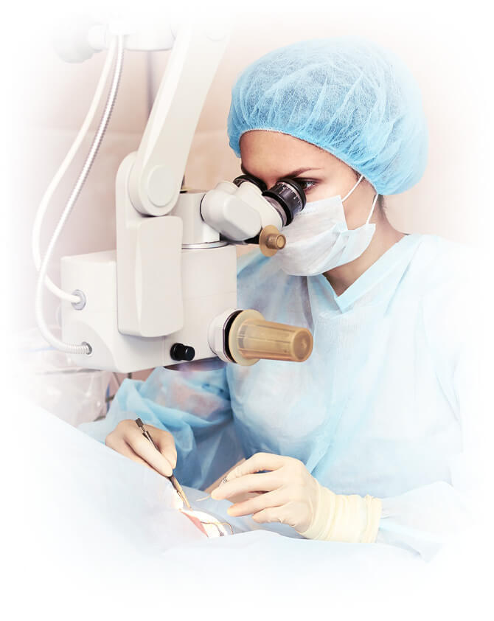
Taking a Proactive Treatment Approach With IG
IG treatments include:
Continuous procedural pharmaceutical systems
Laser treatment
Micro-invasive glaucoma surgery (MIGS)
IG removes the treatment burden for patients and puts control back in the hands of the healthcare provider

Slide 9
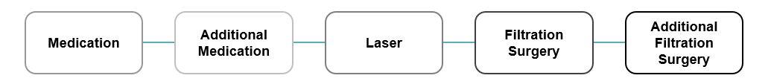
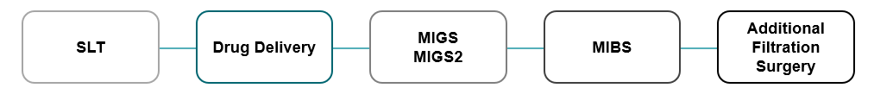
Interventional Glaucoma (IG) Is Establishing a New Method of Treatment
Legacy Treatment Paradigm
A Potential New Standard of Care
Topical Medication as Bridge Therapy
Notes:
Note for speaker:
With IG, the goal is to minimize challenges that come with topical medications by pulling forward procedural interventions and moving medications as a supplement (“bridge therapy”) to be used as needed

Slide 10
The Benefits of Interventional Glaucoma
24/7 Patient Adherence¹
  Puts providers back in control of treatment, reducing failed treatment that stems from patient nonadherence and noncompliance
  Fewer adverse reactions and improved quality of life for patients
Fewer complications than complicated surgeries²
  Straightforward, safer, minimally invasive procedures with lower risk than complicated surgeries
  Faster recovery times than invasive surgeries
Patient benefit in disease-related outcomes
  Helps to mitigate glaucoma progression and improves outcomes for the long term
  Stable and sustained IOP control with consistent medication delivery
Streamlined process and staff benefits thanks to fewer drops
  Elimination of prior authorizations, refill requests, and other prescription challenges
1. Berdahl JP, et al. Efficacy and Safety of the Travoprost Intraocular Implant in Reducing Topical Lowering Medication Burden in Patients with Open-Angle Glaucoma or Ocular Hypertension. Drugs. 2024;84(1):83-97. doi:10.1007/s40265-023-01973-7
2. Balas M, Mathew DJ. Minimally Invasive Glaucoma Surgery: A Review of the Literature. Vision (Basel). 2023;7(3):54. Published 2023 Aug 21. doi:10.3390/vision7030054

Slide 11
What Could This Mean for You?
Fewer requests for prescription eye drops
Fewer prior authorization requirements for branded meds
Fewer phone calls from pharmacies and insurance companies
Less time managing prescriptions
Patients who can be confident they are receiving treatment with 24/7 adherence

Slide 12
A Portfolio of Treatment Options for an Interventional Glaucoma Mindset

Slide 13






The Unparalleled Glaukos Interventional Glaucoma System
iDose TR is a procedural pharmaceutical
iStent infinite is a MIGS
Designed to provide 24/7, long-duration, sustained release of travoprost directly inside the eye; for full range of disease progression
3 stents designed to reduce intraocular pressure (IOP) in patients who failed on previous medical and surgical therapy
DIAGNOSIS
GLAUCOMA THERAPY (STANDALONE OR COMBO-CATARACT)
OCULAR HYPERTENSION
MILD
MODERATE
ADVANCED
REFRACTORY

Slide 14
iDose® TR

Slide 15
iDose® TR Important Safety Information
INDICATIONS AND USAGE
iDose TR (travoprost intracameral implant) is indicated for the reduction of intraocular pressure (IOP) in patients with open angle glaucoma (OAG) or ocular hypertension (OHT).
IMPORTANT SAFETY INFORMATION
Dosage and Administration
For ophthalmic intracameral administration. The intracameral administration should be carried out under standard aseptic conditions.
Contraindications
iDose TR is contraindicated in patients with active or suspected ocular or periocular infections, patients with corneal endothelial cell dystrophy (e.g., Fuch’s Dystrophy, corneal guttatae), patients with prior corneal transplantation, or endothelial cell transplants (e.g., Descemet’s Stripping Automated Endothelial Keratoplasty [DSAEK]), patients with hypersensitivity to travoprost or to any other components of the product.
Warnings and Precautions
iDose TR should be used with caution in patients with narrow angles or other angle abnormalities. Monitor patients routinely to confirm the location of the iDose TR at the site of administration. Increased pigmentation of the iris can occur. Iris pigmentation is likely to be permanent.
Adverse Reactions
In controlled studies, the most common ocular adverse reactions reported in 2% to 6% of patients were increases in intraocular pressure, iritis, dry eye, visual field defects, eye pain, ocular hyperaemia, and reduced visual acuity.
Please see full Prescribing Information.
You are encouraged to report all side effects to the FDA. Visit www.fda.gov/medwatch or call 1-800-FDA-1088. You may also call Glaukos at 1-888-404-1644.

Slide 16
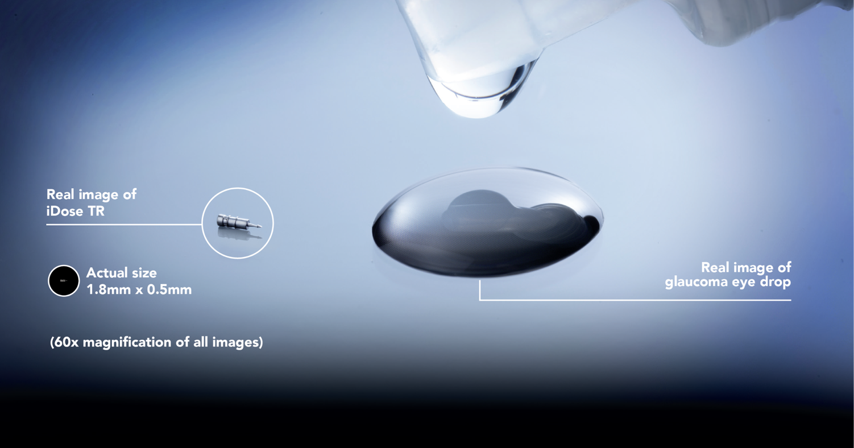
Introducing iDose® TR
An FDA-approved treatment that continuously releases prescription-strength medication inside the eye and ensures your patients get the treatment they need all day and night^{1,2}
1. Sarkisian SR, et al. Ophthalmol Ther. 2024;13(4):995-1014. doi:10.1007/s40123-024-00898-y
2. iDose TR (travoprost intracameral implant) 75 mcg Prescribing Information. Glaukos Corporation. 2023.

Slide 17
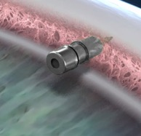
A Groundbreaking Advancement in Glaucoma Treatment
iDose® TR is proven safe and effective¹⁻⁴
Ensures 24/7 patient adherence¹⁻⁴
Helps lower eye pressure
Helps healthcare providers take control of the patient treatment journey
1. iDose TR (travoprost intracameral implant) 75 mcg Prescribing Information. Glaukos Corporation. 2023. 2. Berdahl JP, Sarkisian SR Jr, Ang RE, et al; Travoprost Intraocular Implant Study Group. Efficacy and safety of the travoprost intraocular implant in reducing topical IOP-lowering medication burden in patients with open-angle glaucoma or ocular hypertension. Drugs. 2024;84(1):83-97. doi:10.1007/s40265-023-01973-7 3. Sarkisian SR Jr, Ang RE, Lee AM, et al; GC-010 Travoprost Intraocular Implant Investigators. Phase 3 randomized clinical trial of the safety and efficacy of travoprost intraocular implant in patients with open-angle glaucoma or ocular hypertension. Ophthalmology. Published online February 27, 2024. doi:10.1016/j. ophtha.2024.02.022 4. Sarkisian SR, Ang RE, Lee AM, et al. Travoprost intracameral implant for open-angle glaucoma or ocular hypertension: 12-month results of a randomized, doublemasked trial. Ophthalmol Ther. 2024;13(4):995-1014. doi:10.1007/s40123-024-00898-y

Slide 18

Founded Upon Innovative Technology
Unique Drug Formulation
iDose® TR releases a unique formulation of the same effective medication used in the leading class of prescription eye drops inside the eye in a reliable and consistent manner
Micro-Sized
iDose TR is tiny–200 times smaller than a single drop of glaucoma medication
Fixed and Stable
iDose TR is designed to stay in place and remain stable in the eye. Patients won’t feel it or know it’s there

Slide 19
Clinically Proven to Be Safe and Effective
iDose® TR was proven safe and effective in two large clinical studies of
1,150 patients with glaucoma. In clinical studies^{1,2}
Most patients did not experience any serious side effects. The most common side effects in the eye occurred in only 2%-6% of patients who received
iDose TR.*
Met FDA-required primary efficacy
endpoint through 3 months.
8 out of 10 patients were free of prescription eye drops 12 months after administration of iDose TR.
* The most common side effect of iDose TR was increased eye pressure. The other most common side effects were inflammation of the iris, dry eye, a loss of part of the usual field of vision, eye pain, eye redness (hyperemia; 2.2%), and reduced vision.
1. Berdahl JP, Sarkisian SR Jr, Ang RE, et al; Travoprost Intraocular Implant Study Group. Efficacy and safety of the travoprost intraocular implant in reducing topical IOP-lowering medication burden in patients with open-angle glaucoma or ocular hypertension. Drugs. 2024;84(1):83-97. doi:10.1007/s40265-023-01973-7
2. Sarkisian SR, Ang RE, Lee AM, et al. Travoprost intracameral implant for open-angle glaucoma or ocular hypertension: 12-month results of a randomized, doublemaskedtrial. Ophthalmol Ther. 2024;13(4):995-1014. doi:10.1007/s40123-024-00898-y

Slide 20
iDose® TR Extends Across the Spectrum of Glaucoma Disease
For a variety of patients with open-angle glaucoma or ocular hypertension, iDose TR is appropriate for patients across the spectrum of glaucoma, as a standalone or in combination with cataract surgery¹
OCULAR
HYPERTENSION
MILD
MODERATE
ADVANCED
REFRACTORY
1. iDose TR (travoprost intracameral implant) 75 mcg Prescribing Information. Glaukos Corporation. 2023.

Slide 21
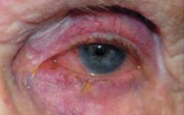
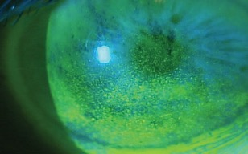
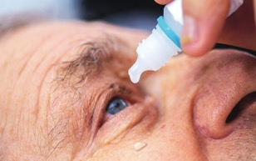
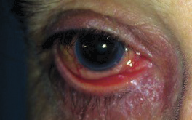
A Wide Range of Patients May Benefit From iDose® TR
Recognizing Patients Who May Benefit From iDose TR:
Are noncompliant/nonadherent with topicals
Are intolerant or allergic to topicals
Experienced side effects that affect quality of life
Are uncontrolled on topicals
Have underlying comorbidities
Underwent prior intervention and remains in need of therapy
Hyperemia
Ocular Surface Disease
Ask patients “What difficulties are you having with your drops?”
Treatment Nonadherence
Periorbital Fat Atrophy

Slide 22
Talking to Patients About iDose® TR
As key members of a patient’s care team, you may be asked about iDose TR. Here are some key points to share:
An FDA-approved treatment that has been shown to be safe and effective¹
Will help reduce eye pressure related to your glaucoma²
Utilizes the same effective prescription medication used in the leading class of eye drops, but iDose TR allows us to place the medication directly inside your eye where it’s most needed instead of requiring you to apply it to your eyes every day¹
Could help reduce some of the challenges, side effects and/or inconveniences with prescription eye drops that you’ve mentioned are a burden³
1. iDose TR (travoprost intracameral implant) 75 mcg Prescribing Information. Glaukos Corporation. 2023.
2. Berdahl JP, et al; Travoprost Intraocular Implant Study Group. Drugs. 2024;84(1):83-97. doi:10.1007/s40265-023-01973-7
3. Sarkisian SR Jr, et al; GC-010 Travoprost Intraocular Implant Investigators. Ophthalmology. Published online February 27, 2024. doi:10.1016/j.ophtha.2024.02.022

Slide 23

Understanding the iDose® TR Procedure¹
A minor procedure performed in a sterile outpatient setting
Patient will receive an anesthetic drop or sedation
iDose TR is gently placed in each eye,
designed to stay in place and remain
stable in the eye
For most people, the procedure is painless
Patient will go home after the procedure and can usually resume normal activities in a day or two
Patient will return for follow-up appointments after the iDose TR procedure
1. iDose TR (travoprost intracameral implant) 75 mcg Prescribing Information. Glaukos Corporation. 2023.

Slide 24
Questions Patients May Ask About iDose® TR
Will the treatment hurt or will I feel the procedure? | No, your eye will be gently sedated. You should not feel anything during or after.
Is iDose TR safe? | iDose TR is shown to be safe and effective. The risk of infection is low.¹
Is iDose TR covered by insurance? | We will check your benefits and confirm you have all the necessary information to proceed. There are also programs to assist, if needed (Medicare Part B, supplemental and/or secondary insurance).
How long will the treatment last? | This treatment is designed to give you a longer duration of therapy than your existing prescription drops today. • 8/10 patients were free of prescription drops at 12 months² • Designed to deliver medication for up to three years³
1. iDose TR (travoprost intracameral implant) 75 mcg Prescribing Information. Glaukos Corporation. 2023. 2. Sarkisian SR Jr, Ang RE, Lee AM, et al; GC-010 Travoprost Intraocular Implant Investigators. Phase 3 randomized clinical trial of the safety and efficacy of travoprost intraocular implant in patients with open-angle glaucoma or ocular hypertension. Ophthalmology. Published online February 27, 2024. doi:10.1016/j. ophtha.2024.02.022 3. Szekely G, Katz LJ, Voskanyan LA, et al. Travoprost intraocular implant (iDose® TR) delivers therapeutically relevant and durable aqueous humor drug concentrations at 24 months. Poster presented at: Association for Research in Vision and Ophthalmology (ARVO) Annual Meeting; May 5-9, 2024; Seattle, WA.

Slide 25
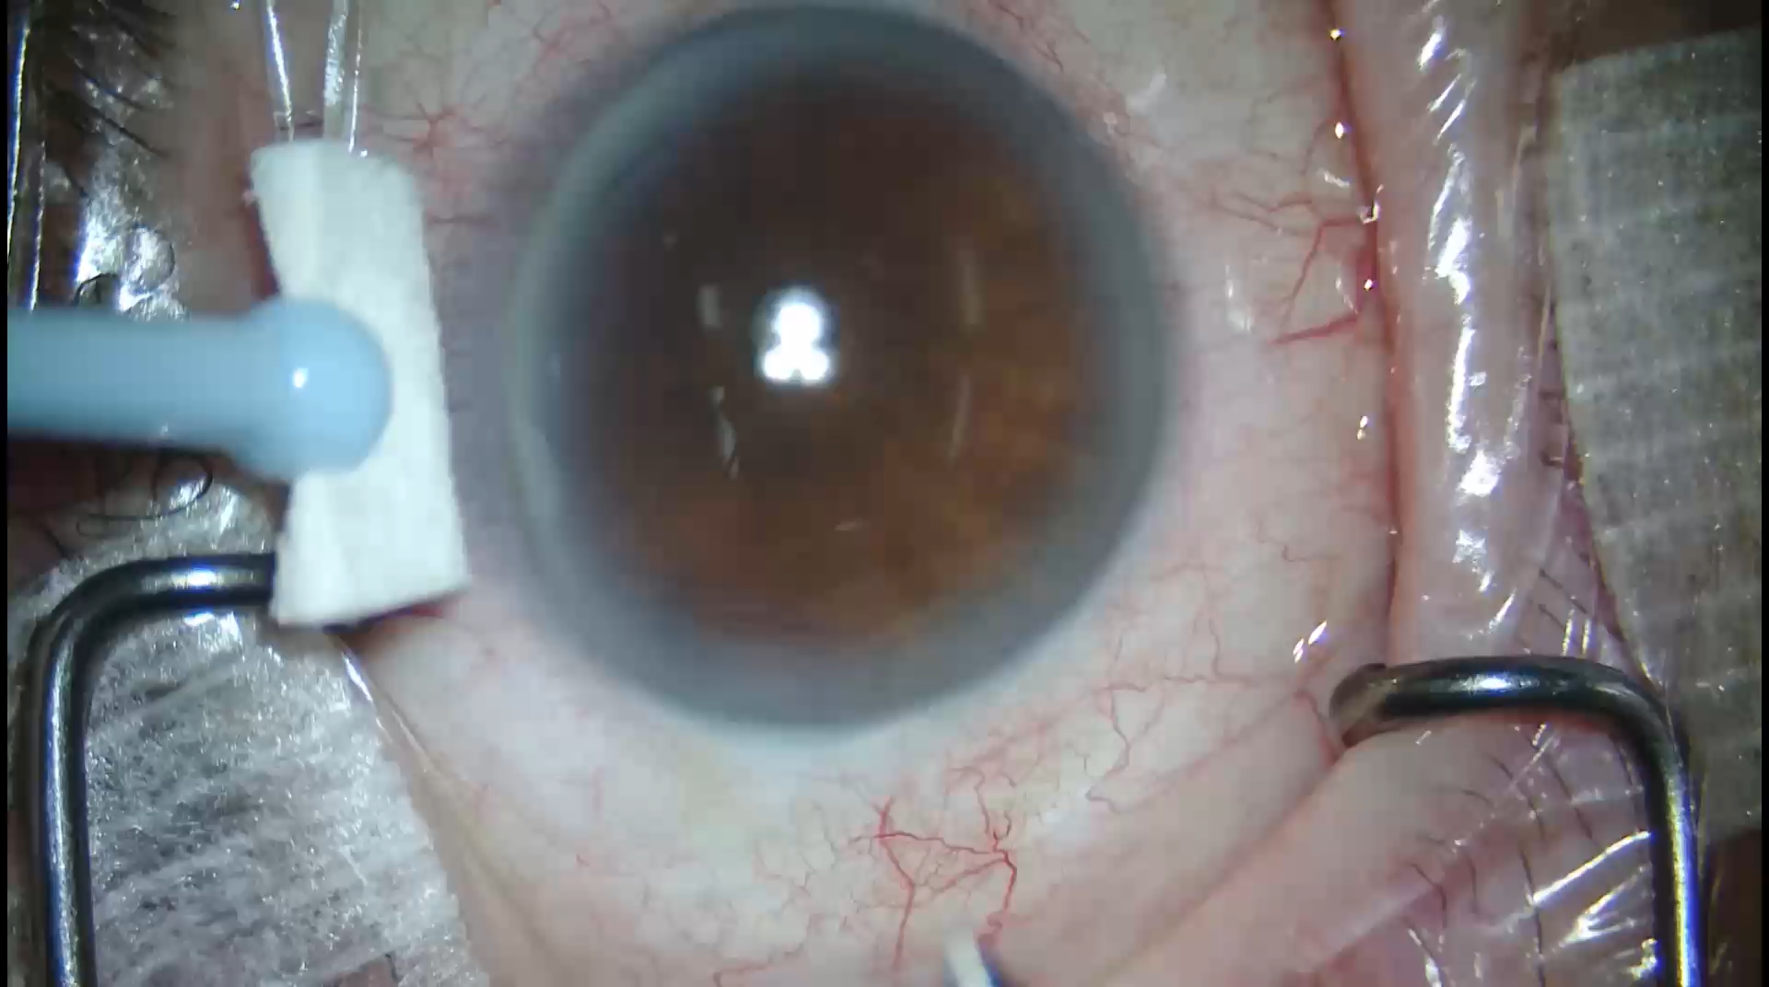
iDose® TR Procedure

Slide 26


Paving the Way to Better Patient Experiences: A Tale of 2 Patients
Both patients have returned to their ophthalmologist with challenges following an initial eye drop prescription for the treatment of high eye pressure associated with their open-angle glaucoma. The following steps were taken:
Patient 1
Ophthalmologist prescribed another eye drop
Required a prior authorization
Resulted in the patient returning again after experiencing additional side effects
Pharmacy follow-up that the new eye drop isn't covered
Patient 2
Patient received an iDose® TR implant
No more prior authorizations or refill requests
Free of prescription eye drops at 12 months¹
Did not experience any serious side effects^{1,2}
24/7 adherence with treatment¹⁻³
RESULT: iDose TR patient is free from drops at 12 months and has not experienced any serious side effects
*Note: This scenario is for demonstrative purposes only and does not represent actual patients.
1. Berdahl JP, Sarkisian SR Jr, Ang RE, et al; Travoprost Intraocular Implant Study Group. Efficacy and safety of the travoprost intraocular implant in reducing topical IOP-lowering medication burden in patients with open-angle glaucoma or ocular hypertension. Drugs. 2024;84(1):83-97. doi:10.1007/s40265-023-01973-7 2. Sarkisian SR, Ang RE, Lee AM, et al. Travoprost intracameral implant for open-angle glaucoma or ocular hypertension: 12-month results of a randomized, doublemaskedtrial. Ophthalmol Ther. 2024;13(4):995-1014. doi:10.1007/s40123-024-00898-y 3. Sarkisian SR Jr, Ang RE, Lee AM, et al; GC-010 Travoprost Intraocular Implant Investigators. Phase 3 randomized clinical trial of the safety and efficacy of travoprost intraocular implant in patients with open-angle glaucoma or ocular hypertension. Ophthalmology. Published online February 27, 2024. doi:10.1016/j. ophtha.2024.02.022

Slide 27
iStent infinite®

Slide 28
iStent infinite® Important Safety Information
INDICATION FOR USE. The iStent infinite® Trabecular Micro-Bypass System Model iS3 is an implantable device intended to reduce the intraocular pressure (IOP) of the eye. It is indicated for use in adult patients with primary open-angle glaucoma in whom previous medical and surgical treatment has failed.
CONTRAINDICATIONS. The iStent infinite is contraindicated in eyes with angle-closure glaucoma where the angle has not been surgically opened, acute traumatic, malignant, active uveitic, or active neovascular glaucoma, discernible congenital anomalies of the anterior chamber (AC) angle, retrobulbar tumor, thyroid eye disease, or Sturge-Weber Syndrome or any other type of condition that may cause elevated episcleral venous pressure.
WARNINGS. Gonioscopy should be performed prior to surgery to exclude congenital anomalies of the angle, PAS, rubeosis, or conditions that would prohibit adequate visualization that could lead to improper placement of the stent and pose a hazard.
MRI INFORMATION. The iStent infinite is MR-Conditional, i.e., the device is safe for use in a specified MR environment under specified conditions; please see Directions for Use (DFU) label for details.
PRECAUTIONS. The surgeon should monitor the patient postoperatively for proper maintenance of IOP. Three out of 61 participants (4.9%) in the pivotal clinical trial were phakic. Therefore, there is insufficient evidence to determine whether the clinical performance of the device may be different in those who are phakic versus in those who are pseudophakic.
ADVERSE EVENTS. The most common postoperative adverse events reported in the iStent infinite pivotal trial included IOP increase ≥ 10 mmHg vs. baseline IOP (8.2%), loss of BSCVA ≥ 2 lines (11.5%), ocular surface disease (11.5%), perioperative inflammation (6.6%) and visual field loss ≥ 2.5 dB (6.6%).
CAUTION: Federal law restricts this device to sale by, or on the order of, a physician. Please see DFU for a complete list of contraindications, warnings, precautions, and adverse events.

Slide 29
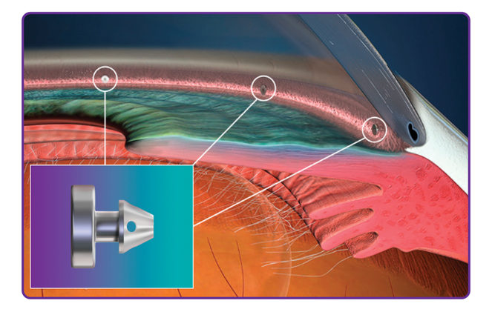
Introducing iStent infinite®
An implantable device intended to reduce the intraocular pressure (IOP) of the eye that can be used in glaucoma patients undergoing cataract surgery or as a standalone procedure

Slide 30
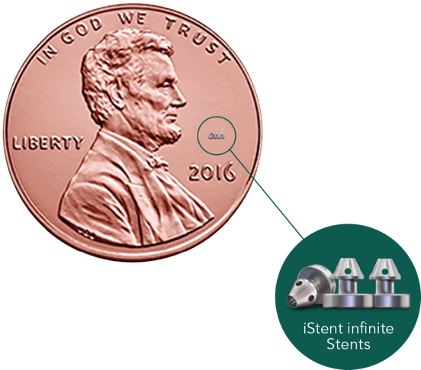
Less Invasive. Fewer Complications.
iStent infinite® can reduce IOP in challenging glaucoma cases, offering an intermediate alternative in place of a more invasive procedure to help treat a variety of patients while minimizing complications and follow-up
See iStent infinite clinical data and ISI at:
https://www.glaukos.com/glaucoma/istent-infinite-clinical-data/

Slide 31
Versatility to Treat a Variety of Patients​
iStent infinite® may be an ideal interventional glaucoma solution for patients in the following situations:
Failed Medical | Failed Surgical
Uncontrolled on medication | Failed filtering surgery (eg, trabeculectomy, tube shunts, XEN)
Noncompliant and nonadherent to treatment | Failed cilioblative surgery
Allergic to glaucoma medication | Other failed surgical intervention (upon surgeon discretion)
Intolerant to glaucoma medication due to sequelae (hyperemia, periorbital fat atrophy, hyperchromia, etc.)
Patients burdened by underlying ocular surface disease
Failed medical patients who have experienced decreased quality of life

Slide 32
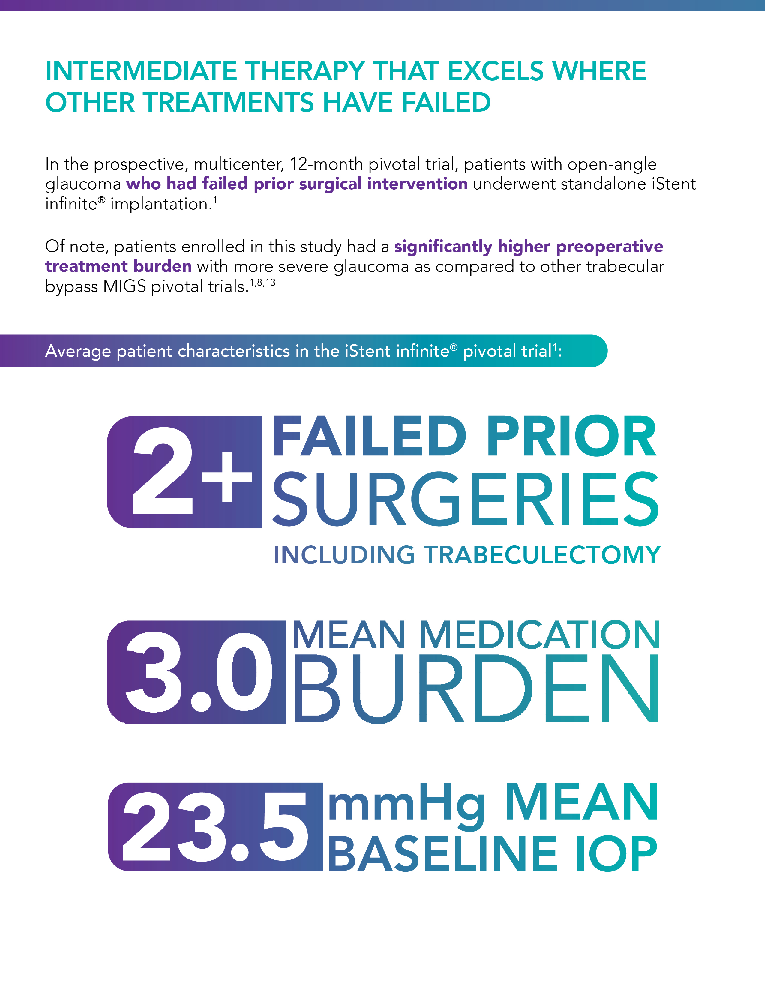
Proven to Excel Where Other Treatments Have Failed
In the prospective, multicenter, 12-month pivotal trial, patients with open-angle glaucoma who had failed prior medical and surgical intervention underwent standalone iStent infinite® implantation.¹
Average patient characteristics in the iStent infinite® pivotal trial¹:
Patients had a significantly higher preoperative treatment burden with more severe glaucoma as compared to other trabecular bypass MIGS pivotal trials.¹⁻³
1. Sarkisian SR Jr, Grover DS, Gallardo M, Brubaker JW, Giamporcaro JE, Hornbeak DM, Katz LJ, Navratil T; iStent infinite® Study Group. Effectiveness and Safety of iStent infinite Trabecular Micro-Bypass For Uncontrolled Glaucoma. J Glaucoma. 2022 Oct 20. doi: 10.1097/IJG.0000000000002141. Epub ahead of print. PMID: 36260288. 2. CyPass. Summary of safety and effectiveness data. Alcon Laboratories, Inc; 2016. 3. Samuelson TW, Chang DF, Marquis R, et al. A Schlemm canal microstent for intraocular pressure reduction in primary open-angle glaucoma and cataract: The HORIZON Study. Ophthalmology. 2019;126(1):29-37.
*Reduction from baseline at 12 months on the same or fewer medications.

Slide 33
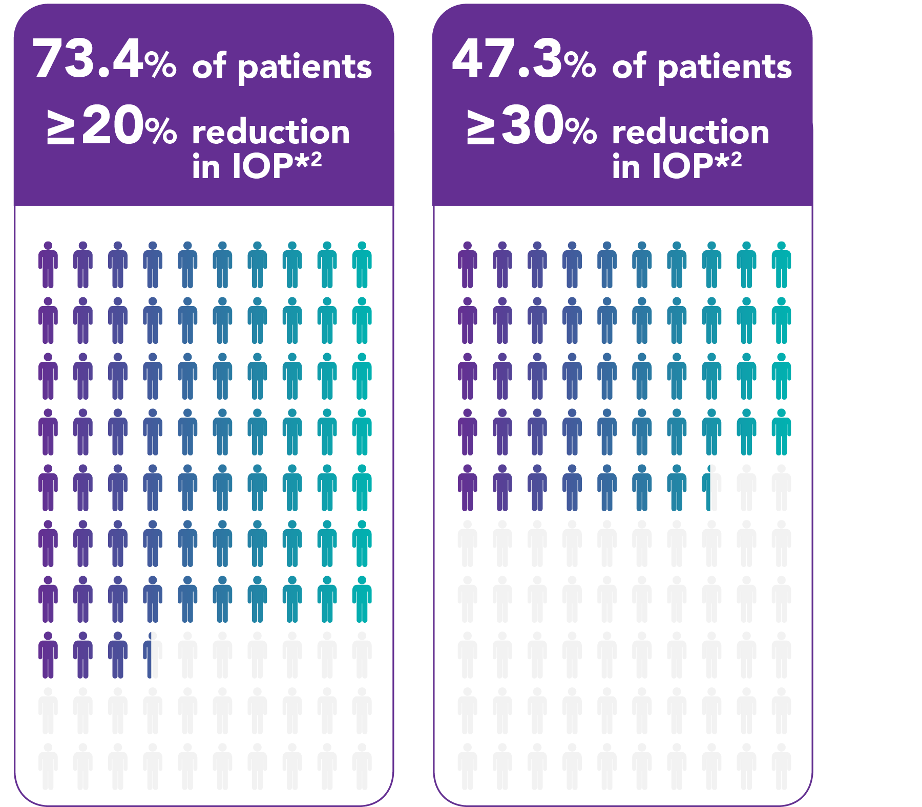
Delivers Sustained Efficacy
Despite this tough-to-treat population, iStent infinite® delivered exceptional results demonstrating sustained efficacy throughout the course of the study.¹
91.7%
of subjects in the failed prior
surgery group reduced or maintained medication burden at 12 months.¹
mean diurnal IOP in patients who did not have an IOP-related SSI (n=57), corresponding to a mean reduction
of 6.5 mmHg (27.7%).²
16.9
mmHg
*Reduction from baseline at 12 months on the same or fewer medications.
1. Sarkisian SR Jr, Grover DS, Gallardo M, Brubaker JW, Giamporcaro JE, Hornbeak DM, Katz LJ, Navratil T; iStent infinite® Study Group. Effectiveness and Safety of iStent infinite Trabecular Micro-Bypass For Uncontrolled Glaucoma. J Glaucoma. 2022 Oct 20. doi: 10.1097/IJG.0000000000002141. Epub ahead of print. PMID: 36260288..
2. iStent infinite. Instructions for use. Glaukos Corporation; 2022.
*Reduction from baseline at 12 months on the same or fewer medications.

Slide 34
Adopting an Interventional Glaucoma Mindset in Your Practice

Slide 35
How Can You Help?
Every practice is different, but there are a few ways you can help to support improving patient outcomes through the adoption of this new mindset

Slide 36
How You Can Help
Patient identification: Patients with current prescriptions for drops or patients with newly diagnosed glaucoma
  iDose® TR candidates: Patients with open-angle glaucoma or ocular hypertension
    Additional consideration: Patients with Medicare Part B and supplemental/secondary insurance​
  iStent infinite® candidates: Patients who have failed on previous medical and surgical treatments
Understanding patients who may most benefit from procedural treatments and who meet the requirements of iDose TR and iStent infinite indications
Driving urgency: Proactively bringing potentially appropriate patients in for a discussion—no need to wait until their next scheduled appointment, which may be months away and could compromise the potential benefits of treating now. Patients are looking for practices that offers interventional therapies and solutions
Patient flagging: Ensuring your doctors are aware of visiting patients who may most benefit from procedural treatments as a reminder for them to initiate the conversation during their appointment
  Pull EMR lists of patients who meet the above criteria and may be on the schedule that week

Slide 37
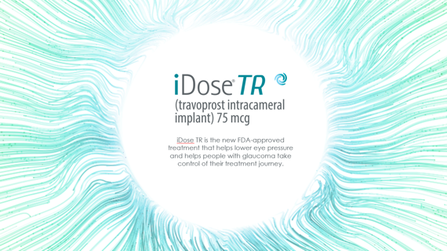
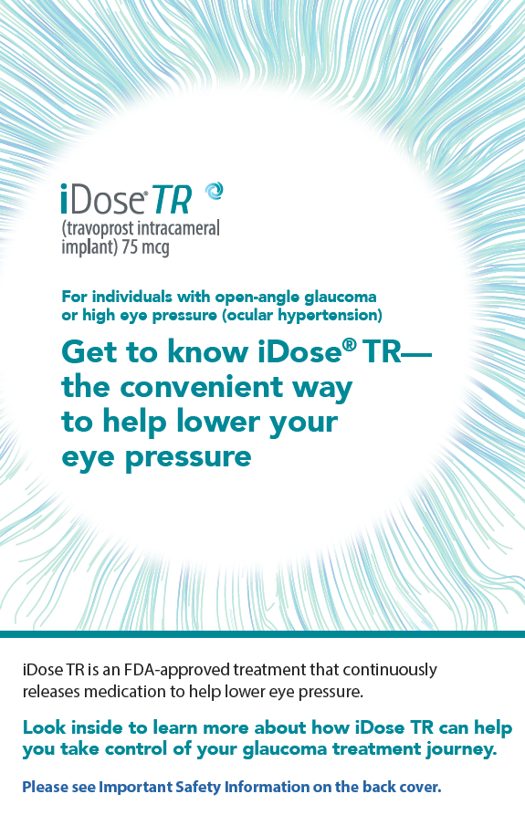
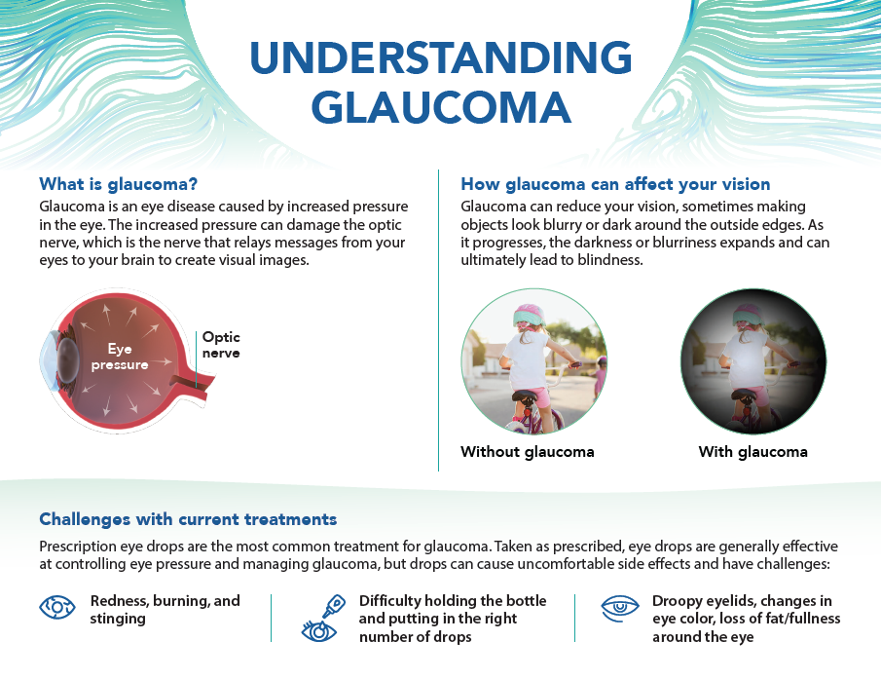
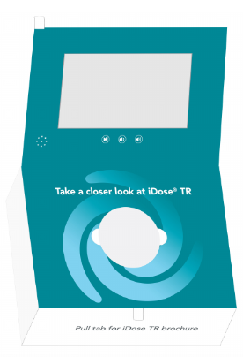
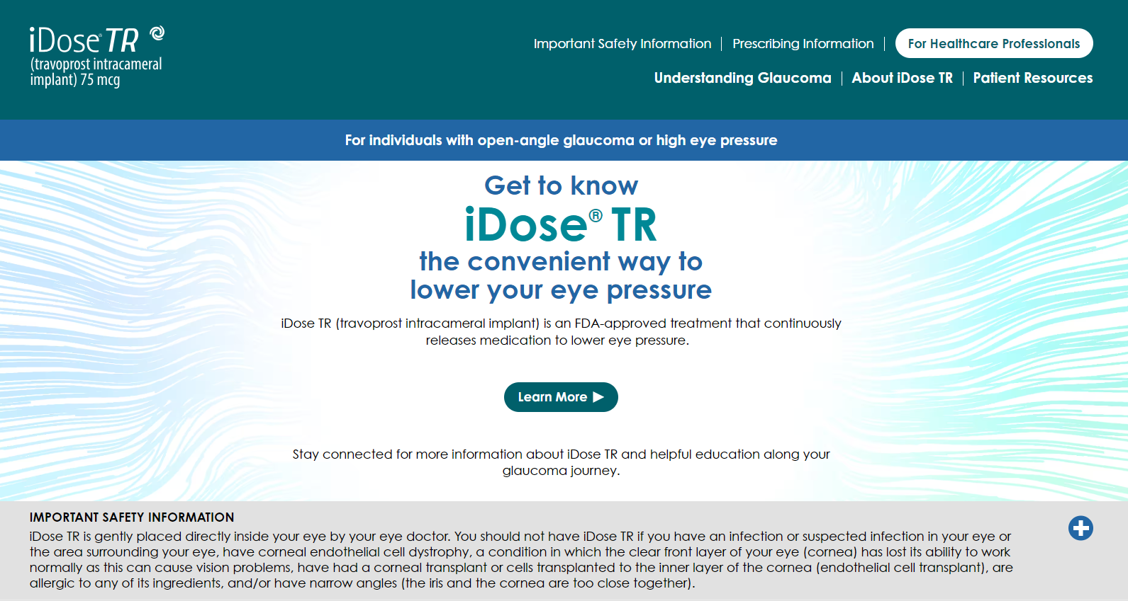
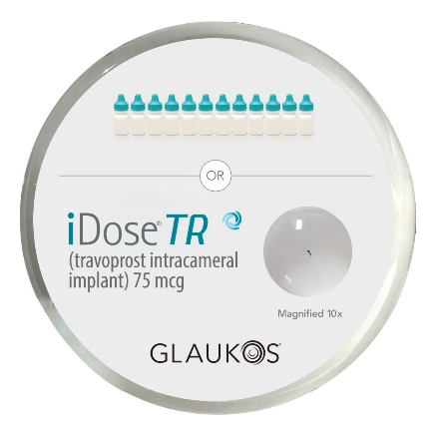
Resources to Support Patient Education
Patient placemat
In-office patient lunch & learn deck
Patient brochure
iDoseTR.com patient website
Patient launch box, including iDose TR hockey puck

Slide 38
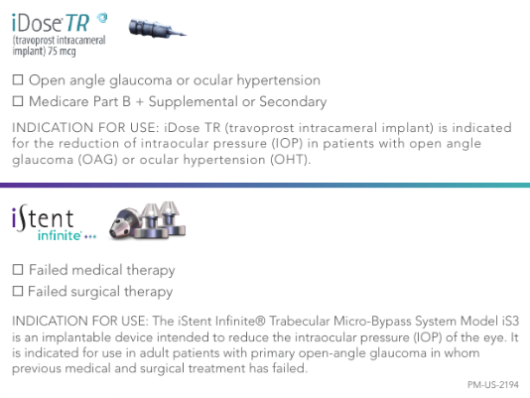
How You Can Help Flag Patient Candidates
These sticky notes are a great tool that will enable you to support your doctors by reminding them of IG appropriate patients to initiate a conversation with during appointments
iDose® TR candidates: Patients with open-angle glaucoma or ocular hypertension
  Additional consideration: Patients with Medicare Part B and supplemental/secondary insurance​
iStent infinite® candidates: Patients who have failed on previous medical and surgical treatments

Slide 39
Your Next Steps
Discuss with your doctors and team how you can support the adoption of the new catalysts for interventional glaucoma (IG) in your practice
To ensure your ophthalmologists are aware of patients who might most benefit from an IG approach, look at your patient roster. Also flag new patients who may benefit from IG
Connect with partnering optometry practices and liaisons, as appropriate, to educate and inform a process for determining appropriate referrals
Talk to patients about the benefits of proactive treatment during their intake process

Slide 40
Thank You
Glaukos, iDose, and iStent infinite are registered trademarks of Glaukos Corporation. © 2024 Glaukos Corporation. All rights reserved. PM-US-2239

Slide 41
Appendix: Additional iDose® TR Data Slides

Slide 42

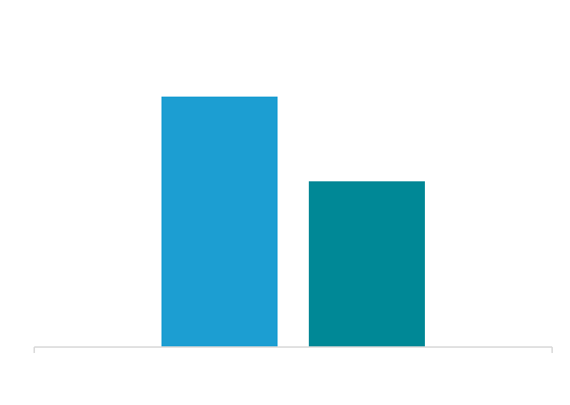
Clinically Proven: Phase 3 and 2b Trial Data Confirm Long Duration
% Patients Well Controlled on the Same or Fewer Topical IOP-Lowering Medications in Phase 2b Trial at 3 Years²
81%
of iDose® TR subjects in the Phase 3 trials were completely free of IOP-lowering topical medications at 12 months.¹
69%
45%
Timolol
0.5% BID
1. Sarkisian SR, Ang RE, Lee AM, et al. Travoprost intracameral implant for open-angle glaucoma or ocular hypertension: 12-month results of a randomized, doublemasked trial. Ophthalmol Ther. 2024;13(4):995-1014. doi:10.1007/s40123-024-00898-y
2. Berdahl JP, Sarkisian SR Jr, Ang RE, et al; Travoprost Intraocular Implant Study Group. Efficacy and safety of the travoprost intraocular implant in reducing topical IOP-lowering medication burden in patients with open-angle glaucoma or ocular hypertension. Drugs. 2024;84(1):83-97. doi:10.1007/s40265-023-01973-7

Slide 43
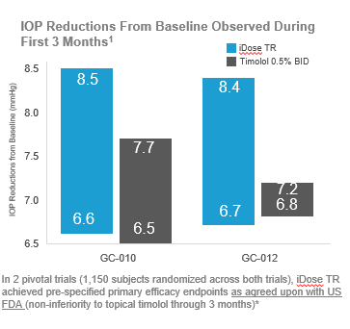
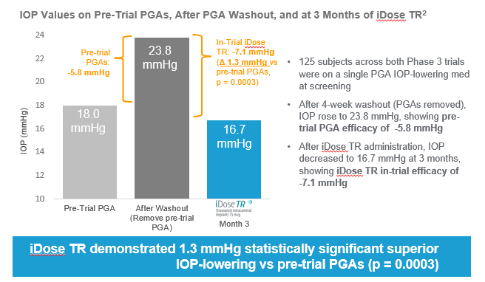
Phase 3 Clinical Trial Overview
81% of iDose® TR subjects in the Phase 3 trials were completely free of IOP-lowering topical medications at 12 months.^{1†}
* Beyond 3-months, while FDA determined iDose TR did not meet non-inferiority, the study was not prospectively powered to do so.
† iDose TR clinical results shown represent the approved and commercially marketed version; identified as the “slow-eluting implant arm” in the pivotal trials.
1. Sarkisian SR, Ang RE, Lee AM, et al. Travoprost intracameral implant for open-angle glaucoma or ocular hypertension: 12-month results of a randomized, double-masked trial. Ophthalmol Ther. 2024;13(4):995-1014. doi:10.1007/s40123-024-00898-y
2. Bacharach J, Doan LV, Stephens KG, et al. Travoprost intracameral implant demonstrates superior IOP lowering versus topical prostaglandin analog monotherapy in patients with open-angle glaucoma or ocular hypertension. Ophthalmol Ther. Published online July 10, 2024. doi:10.1007/s40123-024-00992-1

Slide 44
Phase 2b Trial: Sustained Duration Through 36 Months¹
Percent of Eyes Well Controlled* on Same or Fewer Topical Medications From Baseline
69%
of iDose TR subjects were well controlled on same or fewer topical medications in the Phase 2b trial at 36 months.¹
Responders (%)
* Well controlled was defined as pressures of 18 mmHg and below.
1. Berdahl JP, Sarkisian SR Jr, Ang RE, et al; Travoprost Intraocular Implant Study Group. Efficacy and safety of the travoprost intraocular implant in reducing topical IOP-lowering medication burden in patients with open-angle glaucoma or ocular hypertension. Drugs. 2024;84(1):83-97. doi:10.1007/s40265-023-01973-7

Slide 45
Pharmacokinetic Trial Demonstrated Durable Drug Concentration¹
Open label, single-center study (n=210) to determine in-patient drug elution rate and aqueous humor (AH) exposure to travoprost free acid (TFA)
Mean TFA Concentrations
Mean TFA levels were above CMAX concentration of TFA (1.78 ng/mL) determined after the dosing of topical travoprost; levels were also above efficacious TFA level (.095 ng/mL) estimated after intracameral implant dosing of travoprost
ng/mL
Implant efficacy TFA level (0.095 ng/mL)
Avg Amount of Travoprost Remaining Following Explant
At 24 months, iDose TR implants still contained 16% of the travoprost drug product
% Of Travoprost
1. Szekely G, Katz LJ, Voskanyan LA, et al. Travoprost intraocular implant (iDose® TR) delivers therapeutically relevant and durable aqueous humor drug concentrations at 24 months. Poster presented at: Association for Research in Vision and Ophthalmology (ARVO) Annual Meeting; May 5-9, 2024; Seattle, WA.

