Slide 1

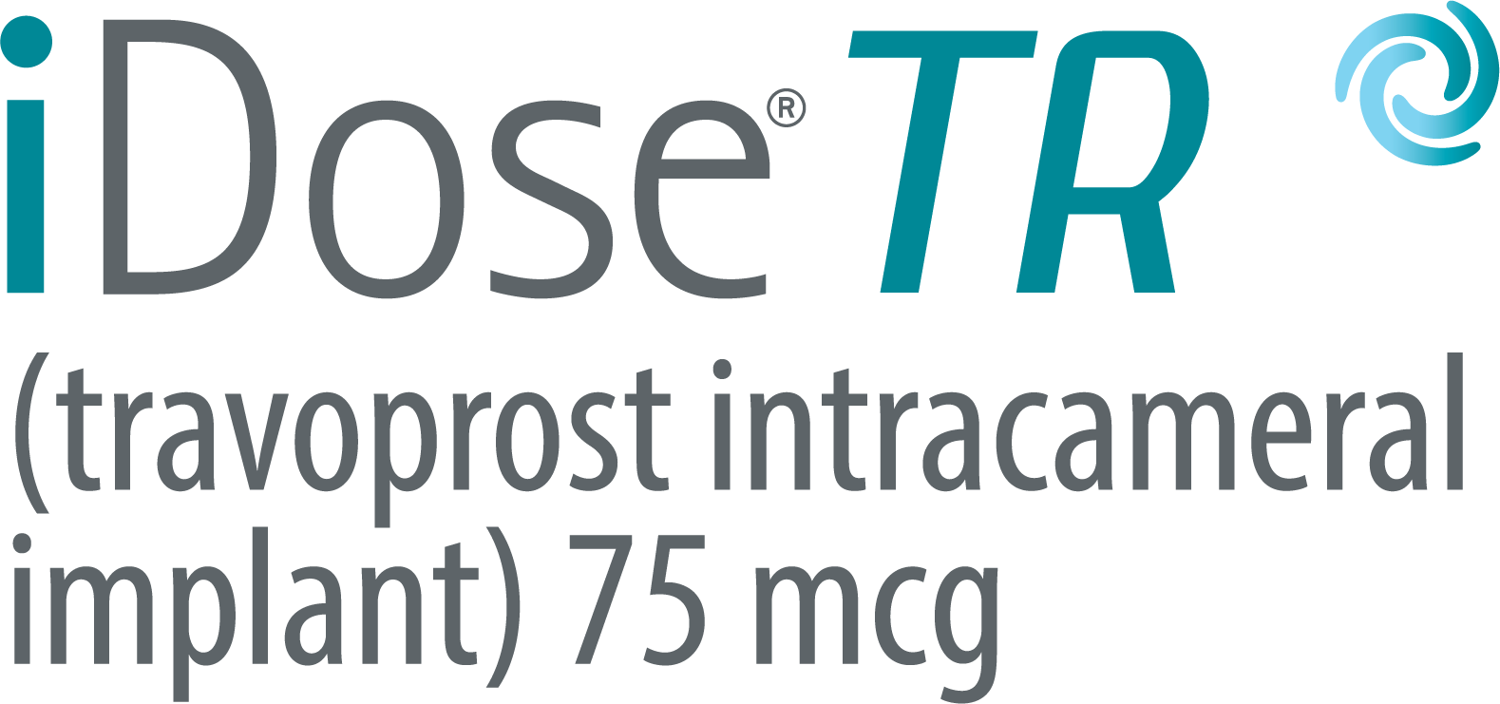
iDose TR is the new FDA-approved treatment that helps lower eye pressure and helps people with glaucoma take control of their treatment journey.

Slide 2
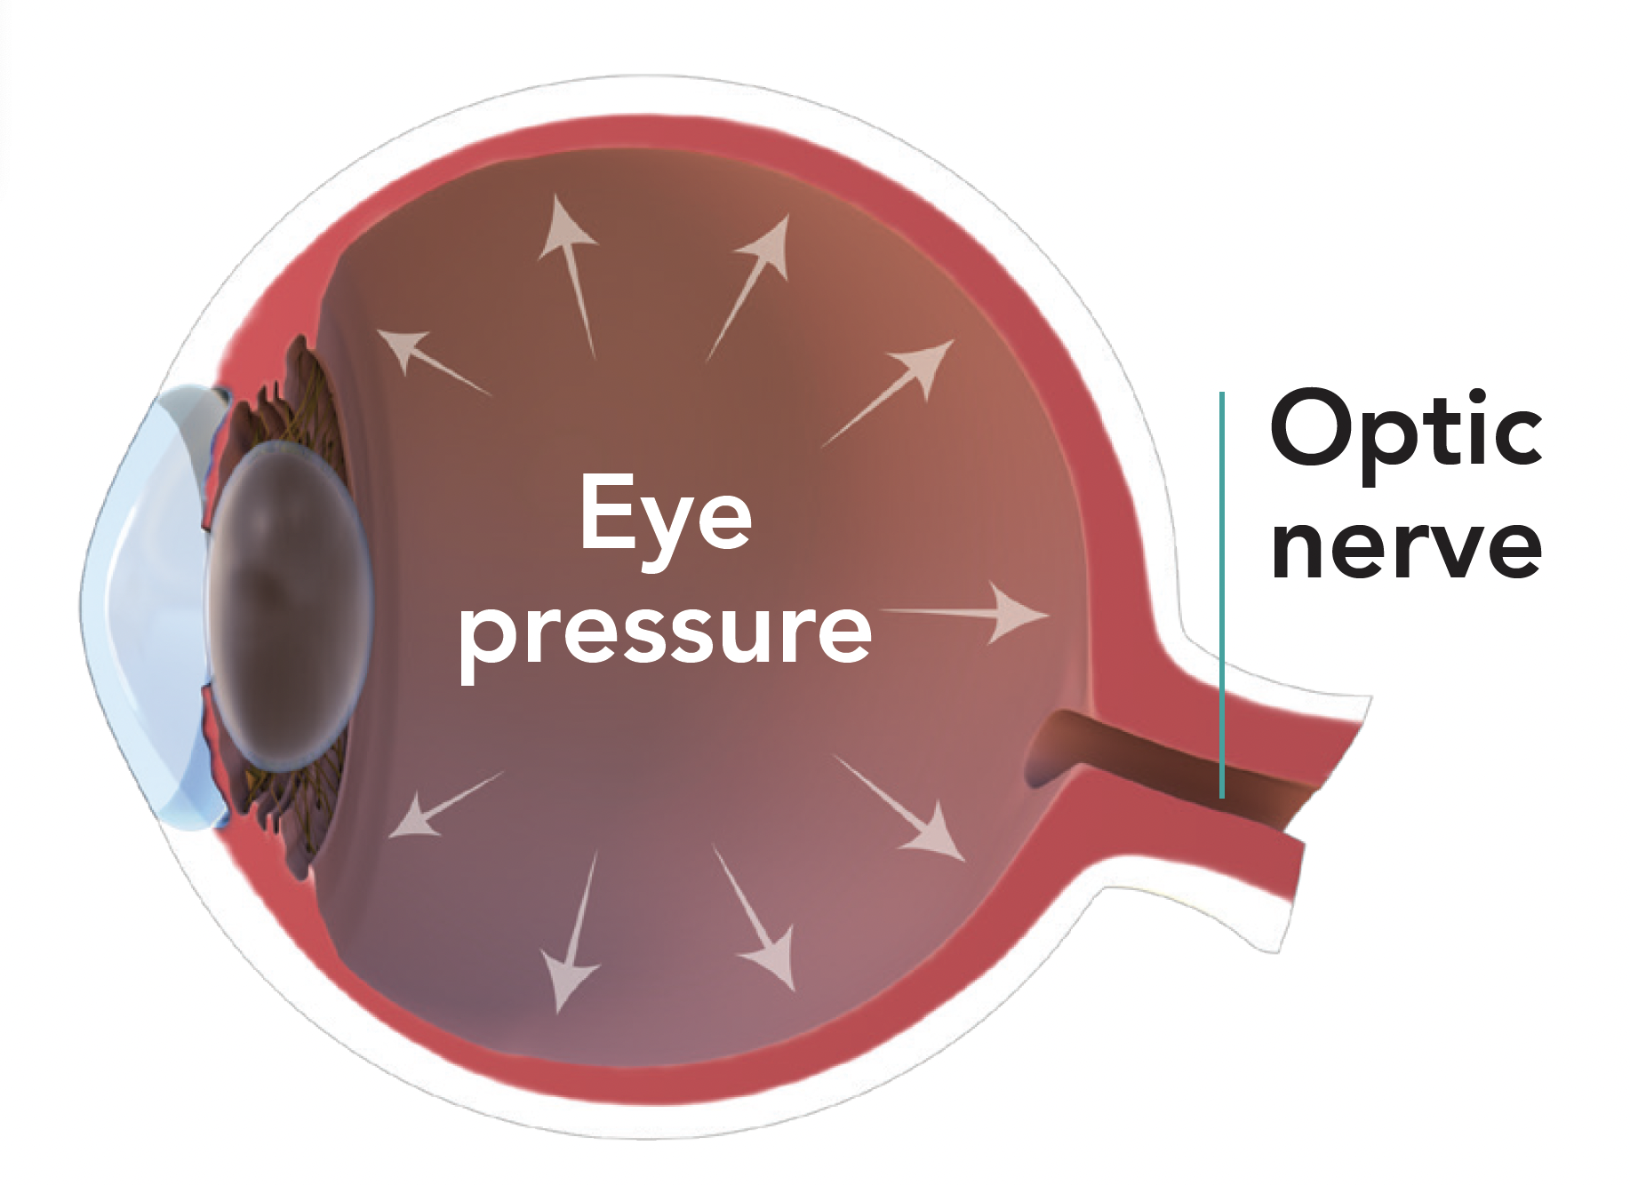


Understanding glaucoma
Disease caused by increased pressure in the eye—intraocular pressure (IOP)
Increased pressure can damage the optic nerve—the nerve that relays messages from your eyes to your brain
  Damage to the optic nerve can affect your vision
  Objects may look blurry or dark around the edges
May present without any symptoms or pain in the early stages
If left untreated, may cause permanent damage to the eye, or blindness

Slide 3
Most common treatment for glaucoma
Prescription eye drops
Generally, very effective at controlling eye pressure when taken as prescribed
However, prescription eye drops have challenges:
  Uncomfortable side effects
  Compliance challenges

Slide 4

Prescription eye drops can be challenging
  Uncomfortable side effects include:
    Red or bloodshot eyes
    Burning and stinging
    Allergic reactions
    Loss of fat or ‘fullness’ around the eyes
    Change in eye color
    Dry eye
    Other medical conditions that affect the eye’s surface
  Inconvenient and easy to forget to administer
  Difficult to administer for people who have arthritis or challenges with hand-eye coordination
  May not be fully absorbed by the eye because of the cornea, which is the protective outer layer
  Have you experienced any of these challenges?

Slide 5
It’s time for something new!

Slide 6
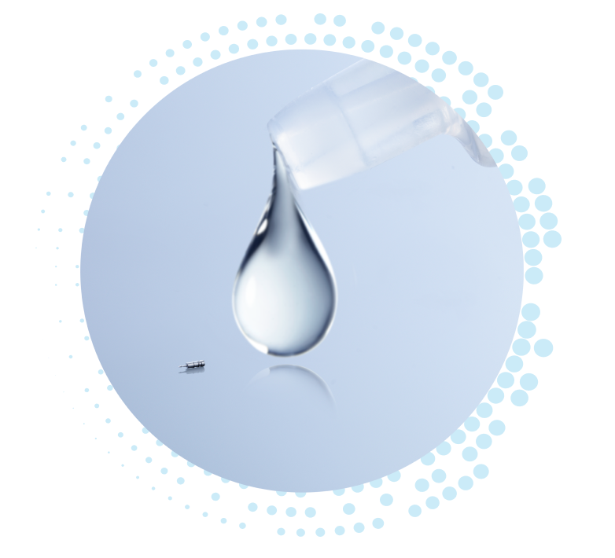
Introducing iDose® TR
An FDA-approved treatment that continuously releases prescription-strength medication inside the eye and ensures you get the treatment you need all day and night
Proven safe and effective
Helps lower eye pressure and helps you take control of your glaucoma treatment journey
iDose TR (travoprost intracameral implant) 75 mcg is a tiny implant. It is approximately 200 times smaller than a single drop of glaucoma medication

Slide 7

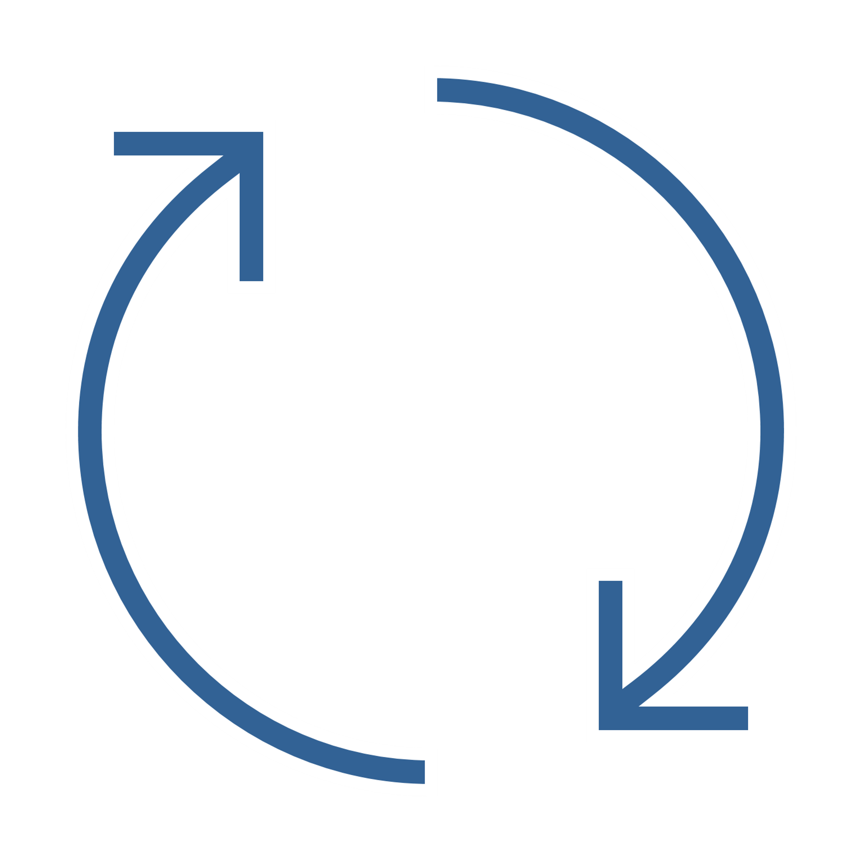


iDose® TR is the next step forward in lowering high eye pressure associated with glaucoma
Hands-free treatment that can reduce the hassle of taking daily prescription eye drops
Convenient alternative to
prescription eye drops
Releases medication directly inside your eye, where it's most needed
Proven to help keep your eye pressure under control
In a clinical study, 8 out of 10 patients did not need prescription eye drops 12 months after administration of iDose TR.

Slide 8
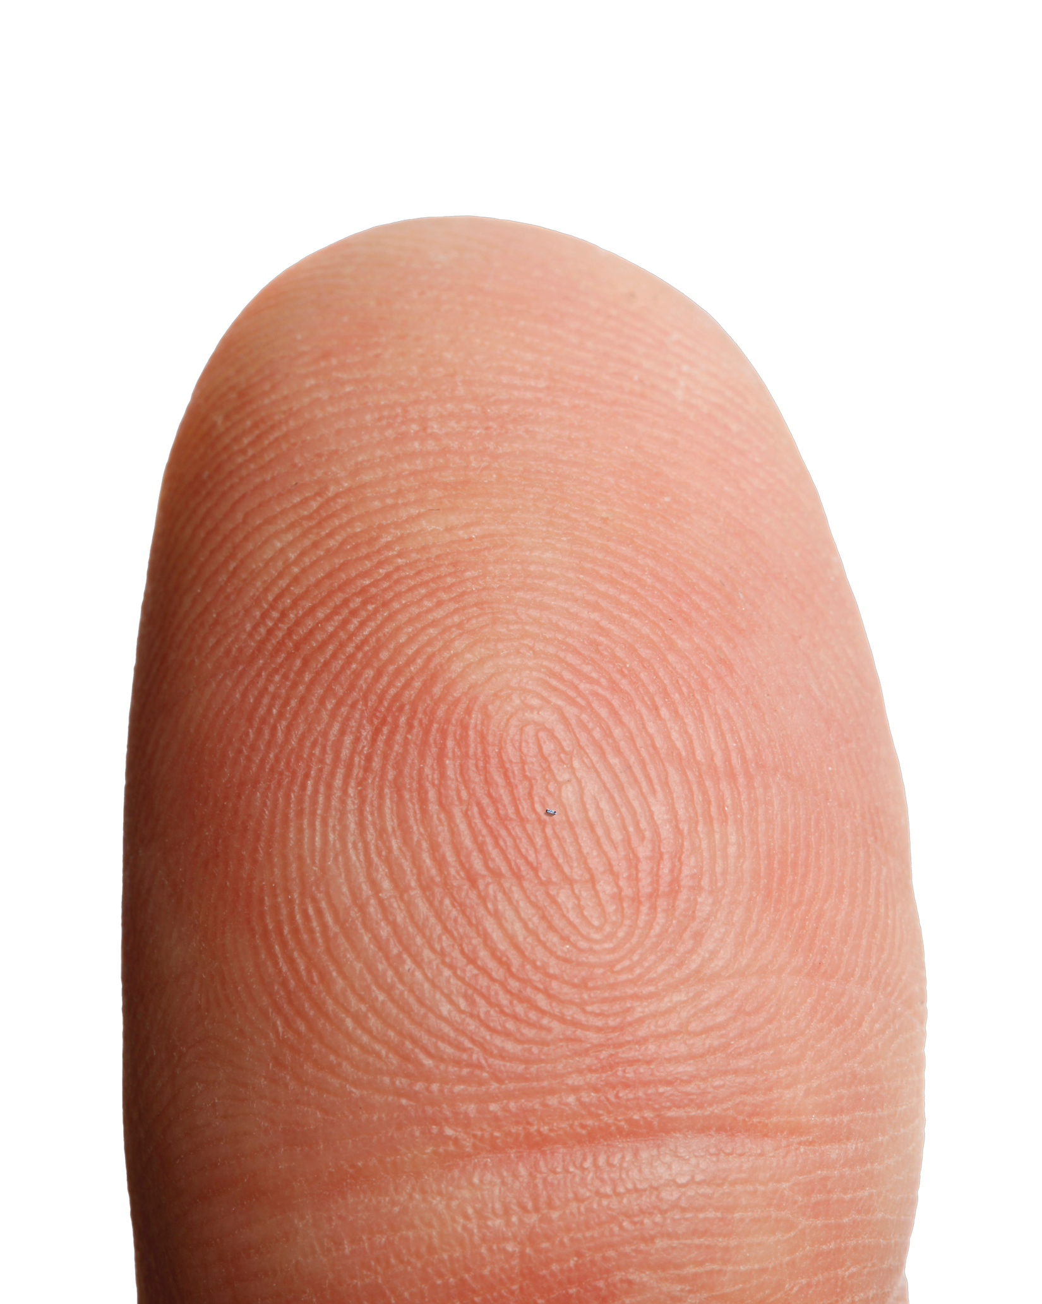
Advanced technology backed by a safe procedure with minimal downtime
A minimally invasive procedure performed in a sterile outpatient setting
You will receive an anesthetic drop or sedation
iDose® TR is gently placed in each eye.
Designed to stay in place and remain stable
in the eye
For most people, the procedure is painless
You can go home after the procedure and can usually go about your normal activities in a day or two
Your doctor will talk with you about follow-up appointments after your iDose TR procedure

Slide 9
Proven safe and effective
iDose® TR was proven safe and effective in two large clinical studies of
1,150 patients with glaucoma.
In the clinical studies with iDose TR, most patients did not experience any serious side effects. The most common side effects in the eye occurred in only 2 to 6% of patients who received iDose TR.*
iDose TR is designed to start working immediately to help keep your eye pressure under control.
* Most of the common side effects were mild. The most common side effect of iDose TR was increased eye pressure. The other most common side effects were inflammation of the iris, dry eye, a loss of part of the usual field of vision, eye pain, eye redness, and reduced vision.

Slide 10



Glaukos is committed to supporting patients with glaucoma
Insurance coverage support
Co-pay programs*
  Patient assistance programs
* Patients who qualify may pay as little as $0 for iDose TR, one implant per eye–offer valid only for commercially insured patients with a plan covering iDose TR; patient out-of-pocket expense may vary.

Slide 11
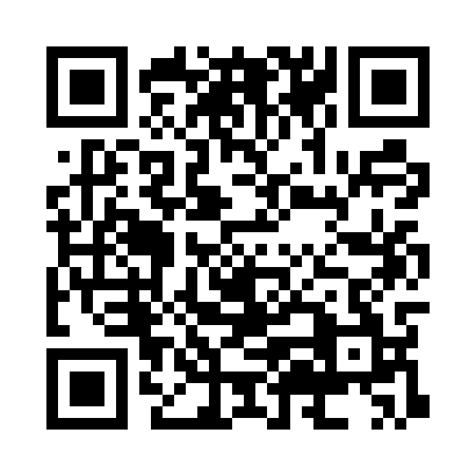
IMPORTANT SAFETY INFORMATION
iDose TR is gently placed directly inside your eye by your eye doctor.
You should not have iDose TR if you have an infection or suspected infection in your eye or the area surrounding your eye, have corneal endothelial cell dystrophy, a condition in which the clear front layer of your eye (cornea) has lost its ability to work normally as this can cause vision problems, have had a corneal transplant or cells transplanted to the inner layer of the cornea (endothelial cell transplant), are allergic to any of its ingredients, and /or have narrow angles (the iris and the cornea are too close together).
The most common side effect of iDose TR was increased eye pressure. Other common side effects were inflammation of the iris, dry eye, a loss of part of the usual field of vision, eye pain, eye redness and reduced clearness of vision.
If you have additional questions, please contact your doctor.
For full Prescribing Information visit www.idosetr.com.
APPROVED USES
iDose TR (travoprost intracameral implant) is a prescription medicine and drug delivery system for the eye approved to lower eye pressure in patients with open-angle glaucoma or high eye pressure (ocular hypertension).
You are encouraged to report all side effects to the FDA. Visit www.fda.gov/medwatch, or call 1-800-FDA-1088. You may also call Glaukos at 1-888-404-1644.
View full prescribing information at iDoseTR.com
©2024 Glaukos Corporation. All rights reserved. Glaukos and iDose are registered trademarks of Glaukos Corporation. PM-US-1859.

Slide 12
Any questions?

